Slide 1
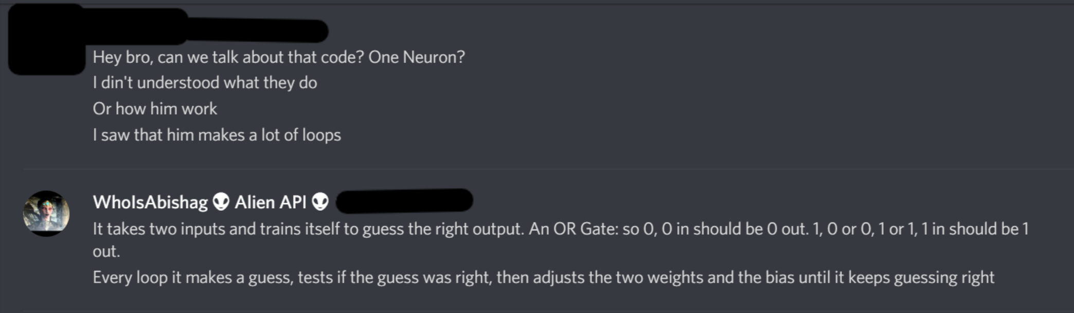
ONE Neuron Training
Some text here

Slide 2
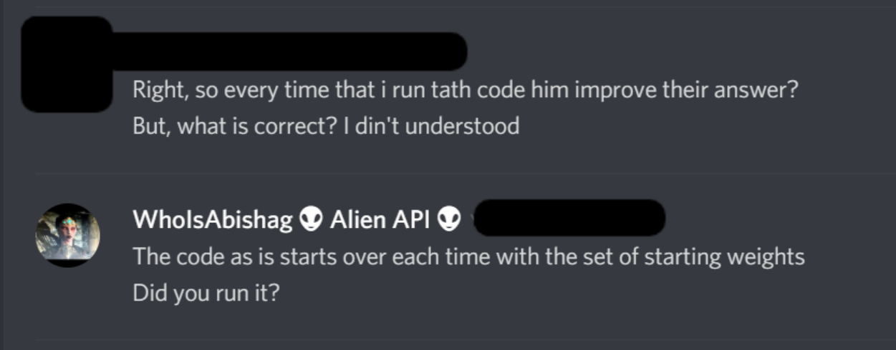
ONE Neuron Training
Some text here

Slide 3
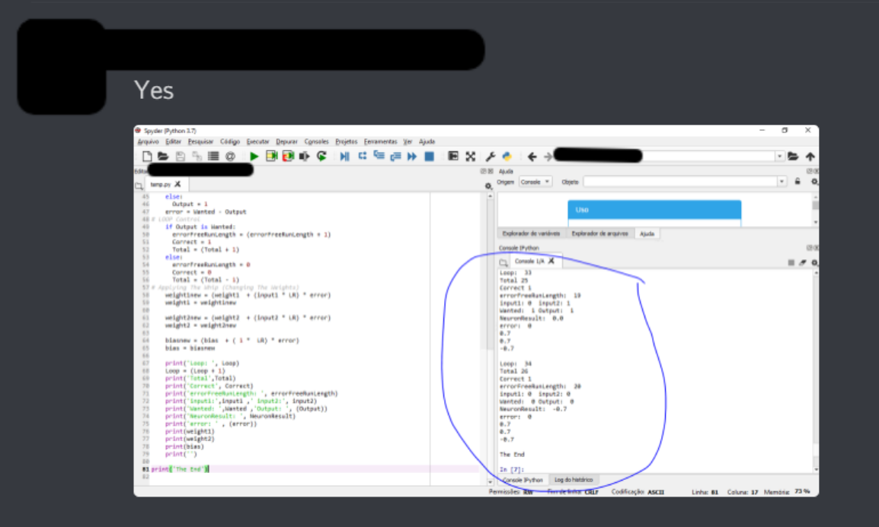
ONE Neuron Training
Some text here

Slide 4
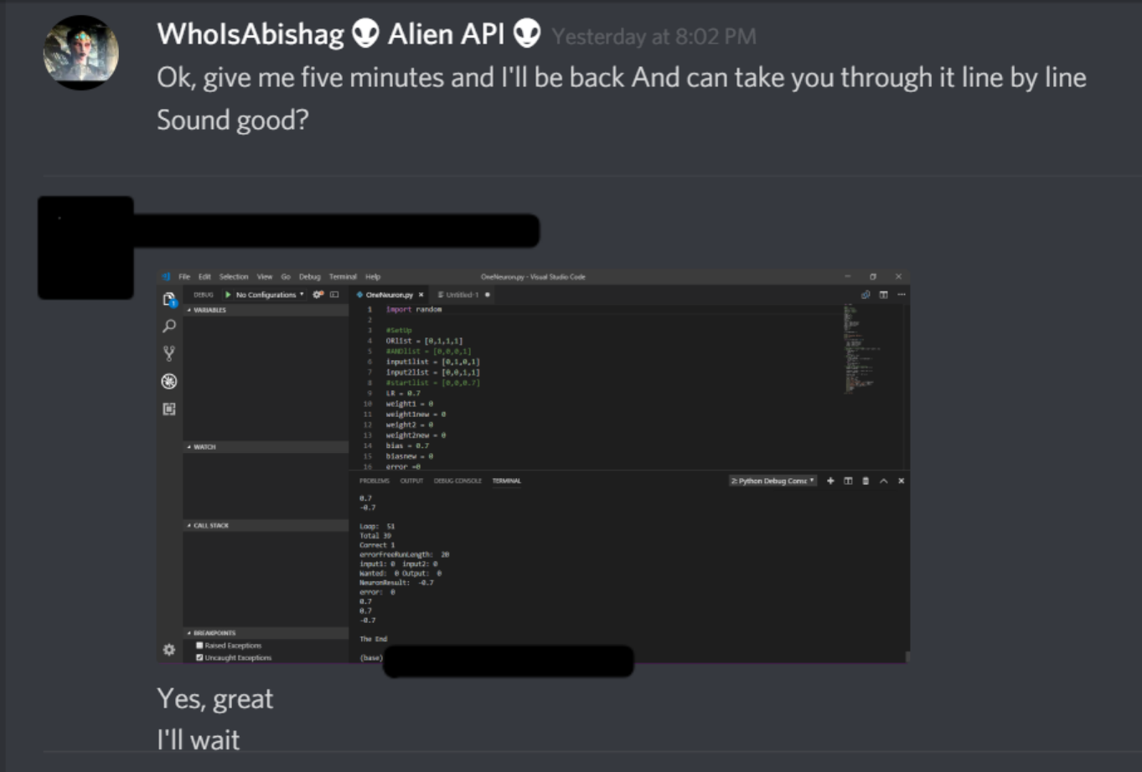
ONE Neuron Training
Some text here

Slide 5
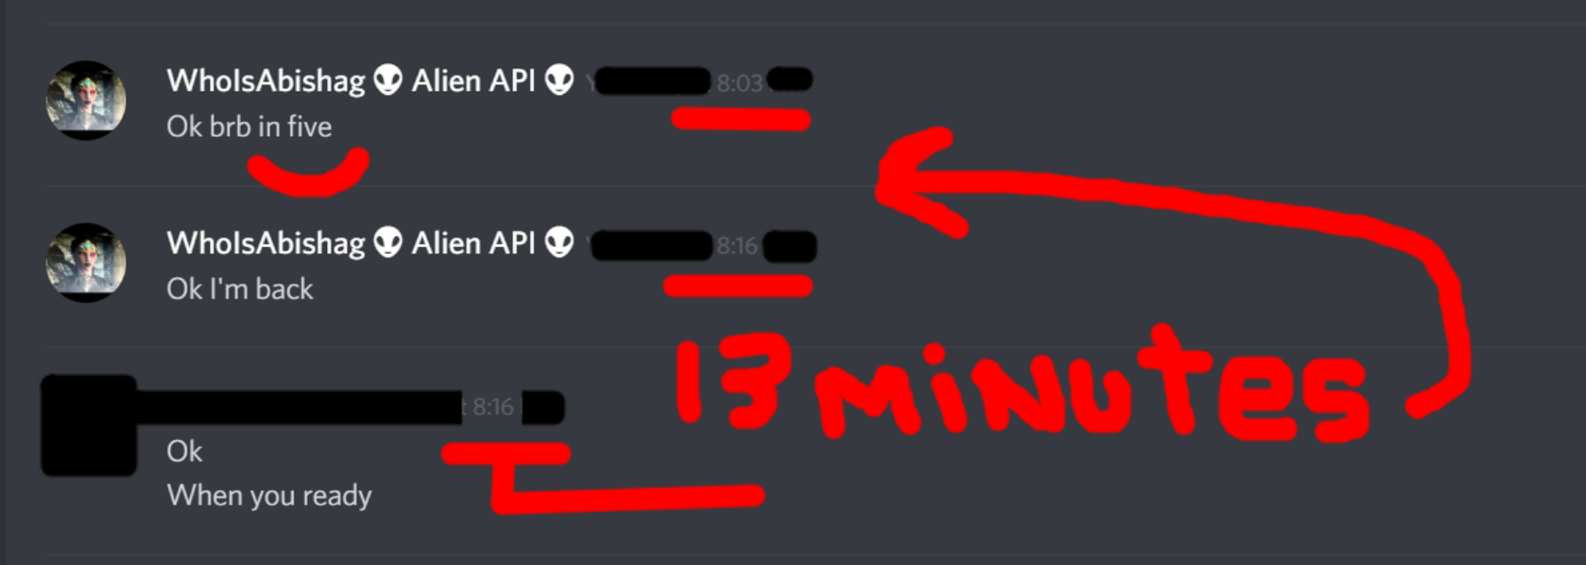
ONE Neuron Training
Some text here

Slide 6
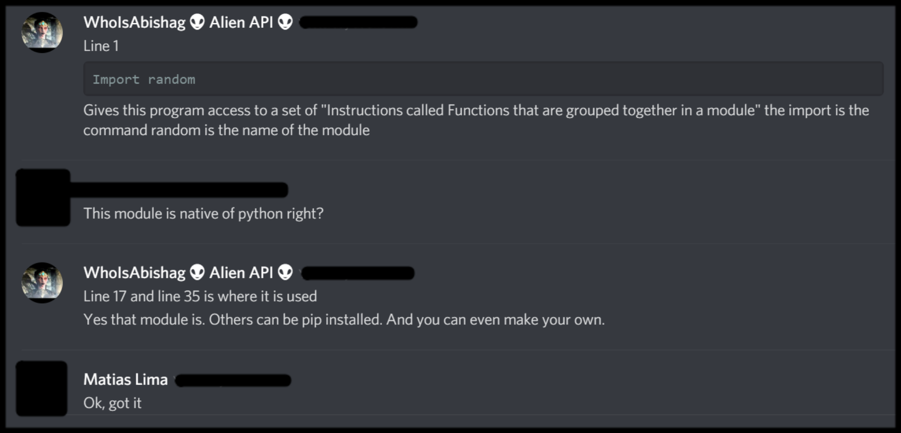
ONE Neuron Training
Some text here

Slide 7
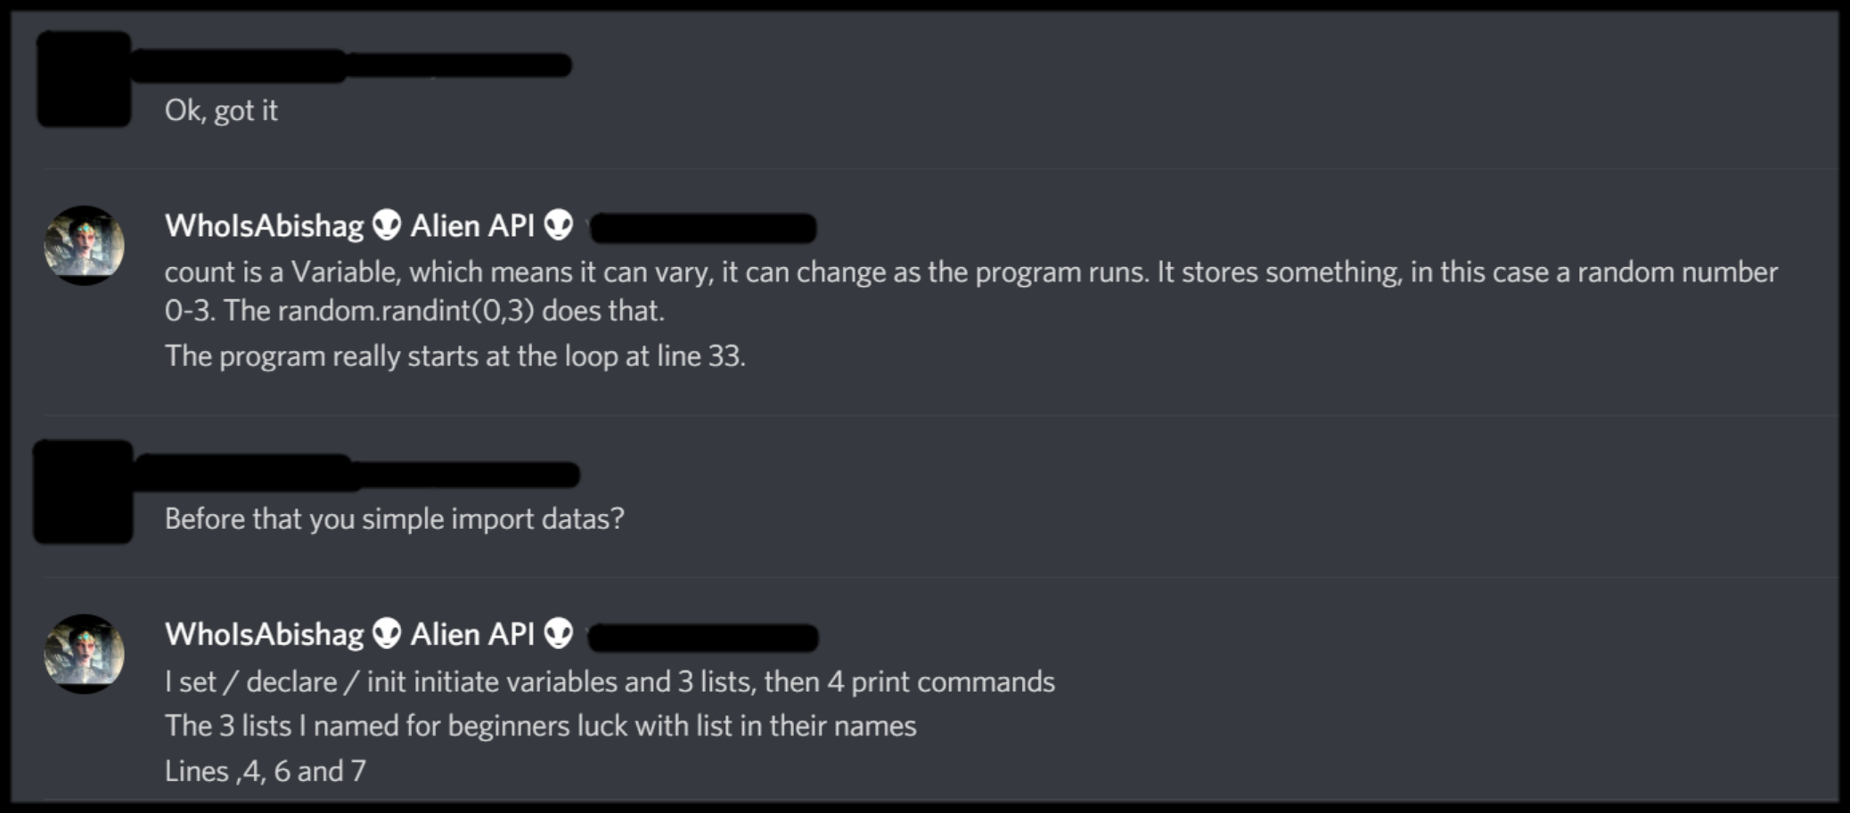
ONE Neuron Training
Some text here

Slide 8
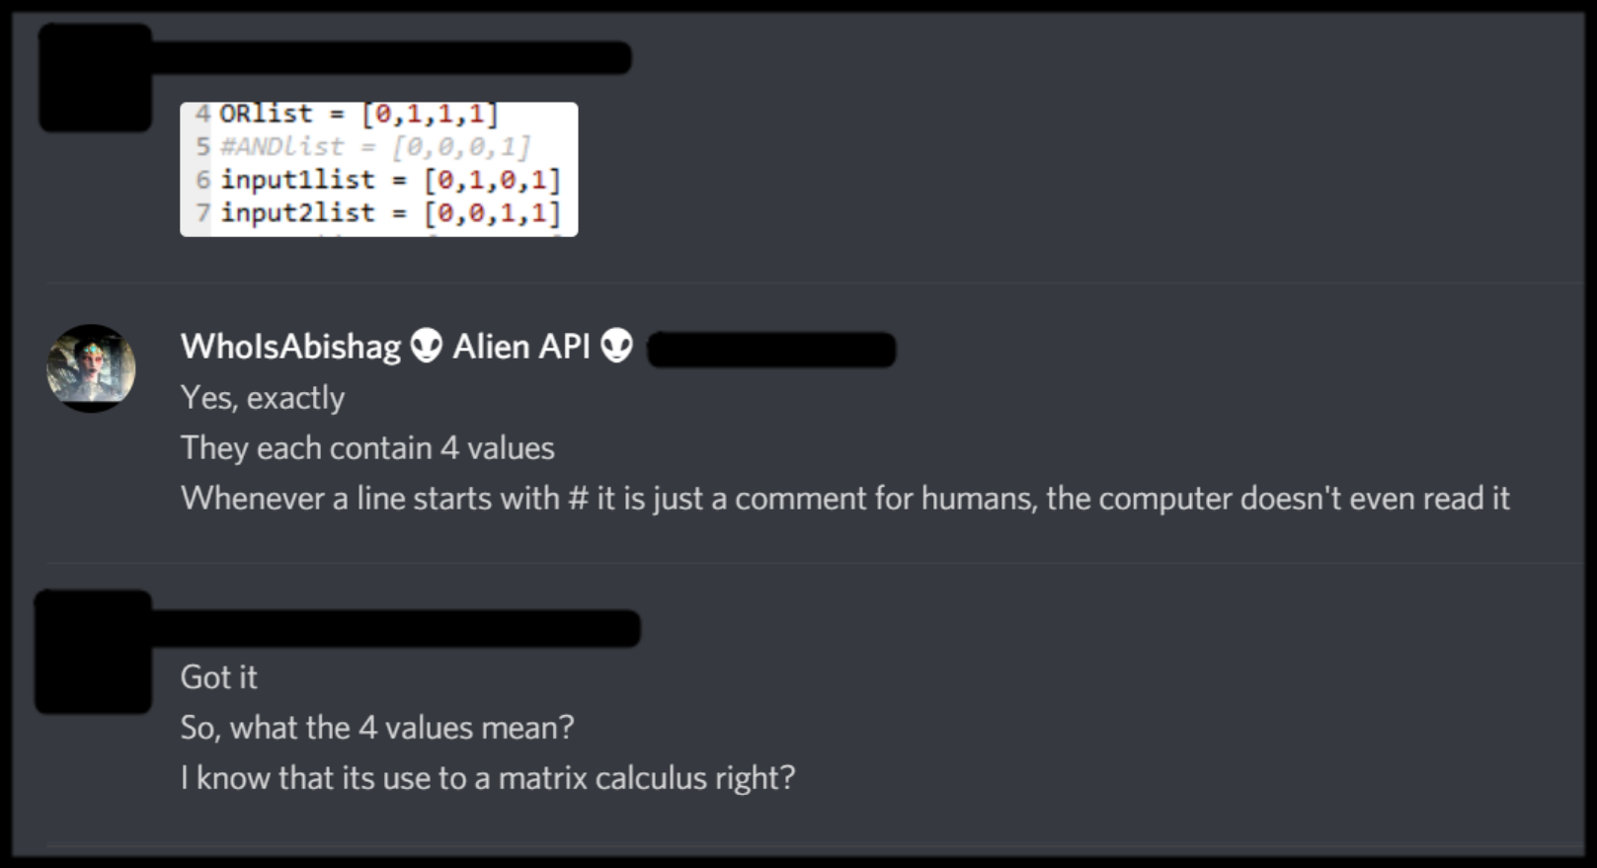
ONE Neuron Training
Some text here

Slide 9
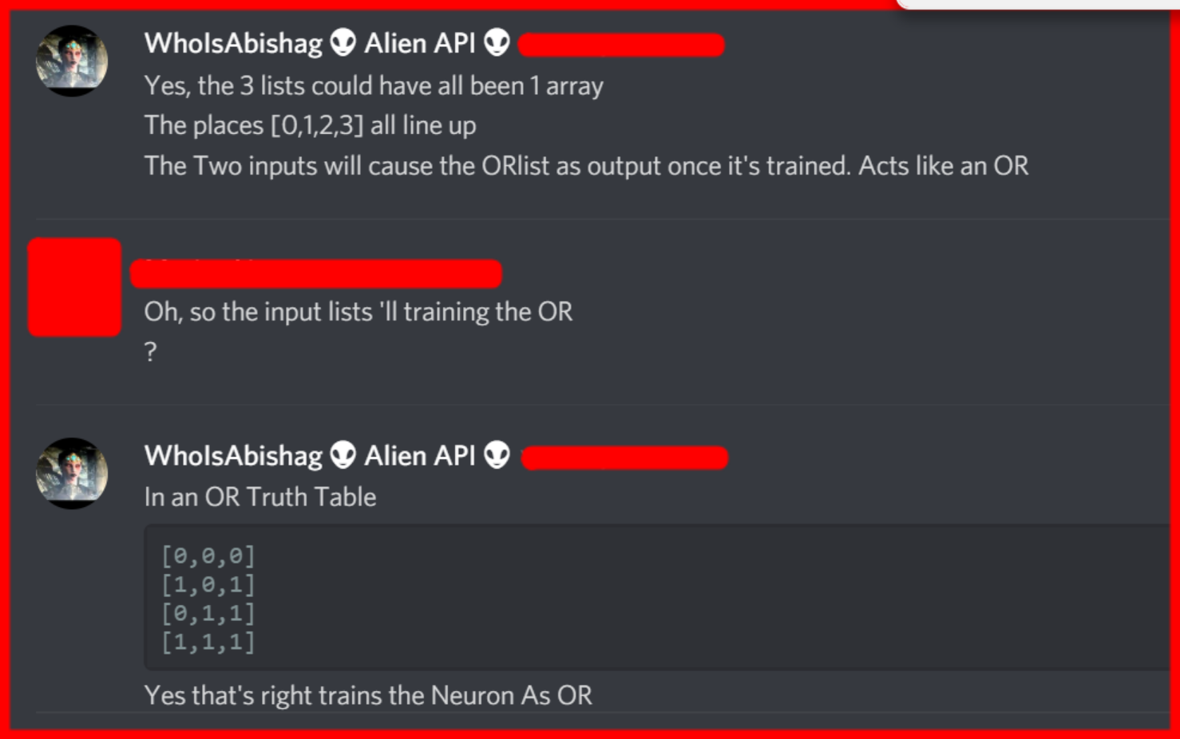
ONE Neuron Training
Some text here

Slide 10
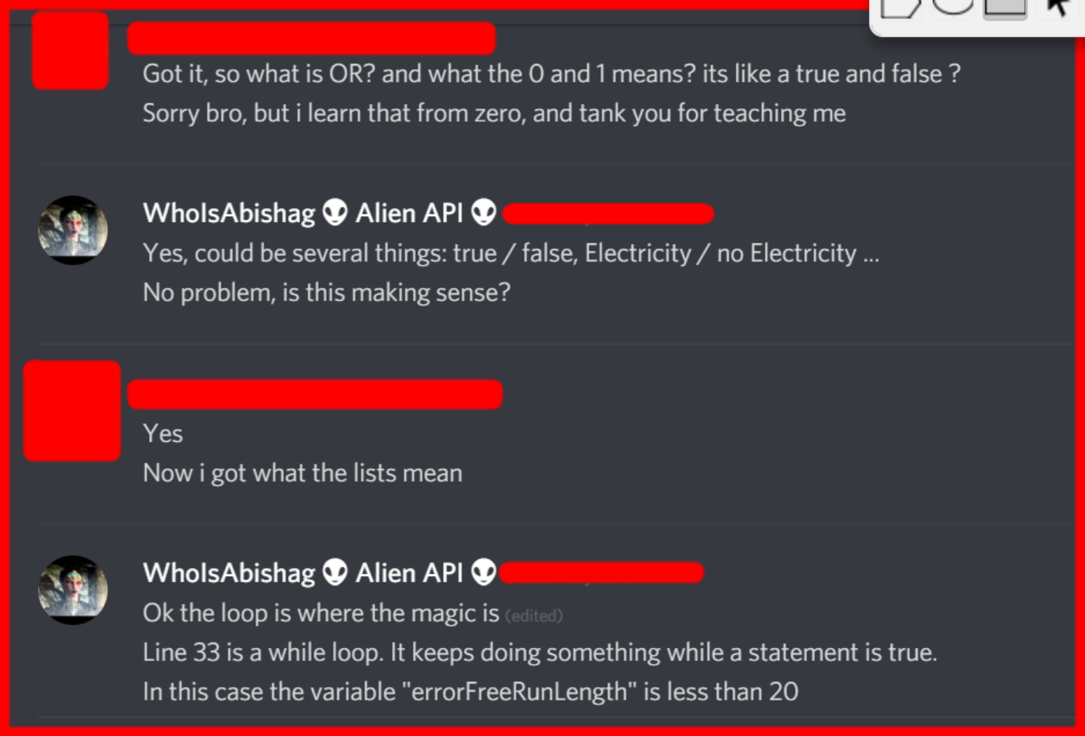
ONE Neuron Training
Some text here

Slide 11
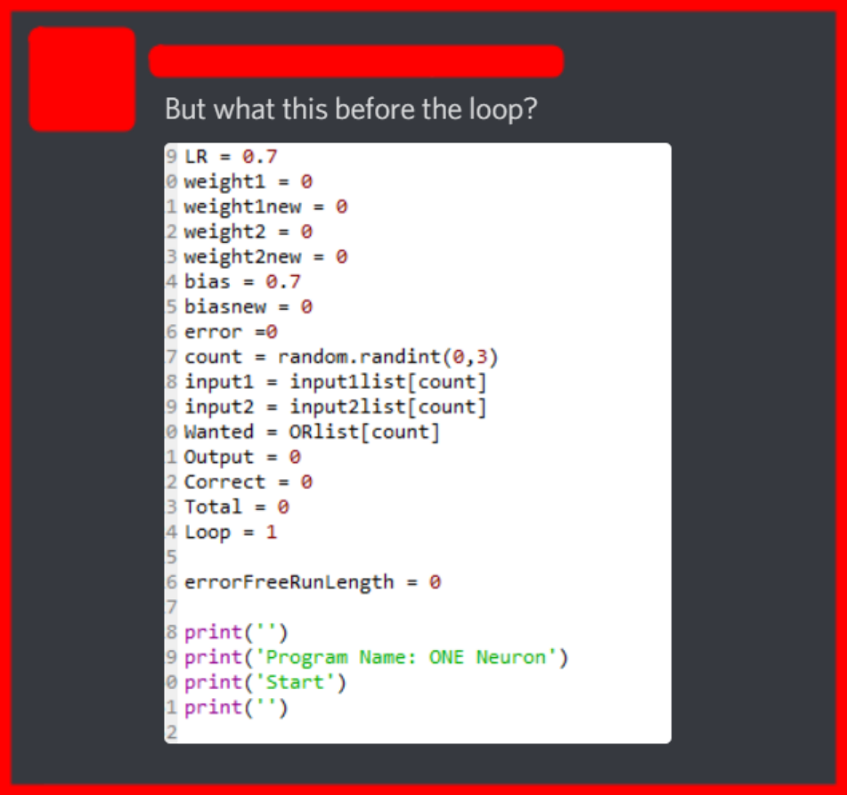
ONE Neuron Training
Some text here

